Slide 1
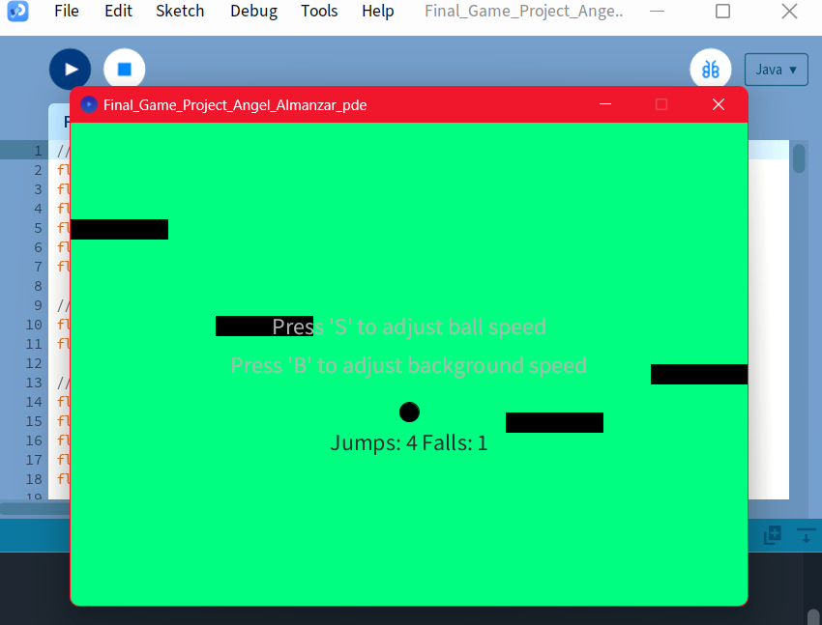
Final Game-Hue Hopping Prism Game
By Angel Almanzar

Slide 2
How does this game work? Here are the details…
“Hue Hopping Prism Game” is an original thought out game of mine inspired by games like “Beat Stomper” and “Smash Hit”. Two games I loved playing as a kid. The game is a physics based game that I was inspired to make after trying a physics game online. The players control a ball that jumps and moves in different directions, across a colorful background. The goal of this simple and very easy game is to avoid the moving platforms (obstacles),you can adjust the ball speed and background color change speed while aiming for a high jump count.
When getting a high jump count and it is over, the game says you have a new high score. There are no characters in this game, I just have objects in the game. The game is set with a plain colorful background, the colors are a part of the game's setting to make it feel fun. There are some help options displayed on the screen.
Players control the ball using keyboard inputs:
UP arrow key: Jump
LEFT and RIGHT arrow keys: Move the ball horizontally
'S' key: Increase ball speed
'B' key: Increase background color change speed
The ball jumps with a physics-based motion influenced by gravity.
Obstacles move horizontally, posing challenges for the player to avoid collisions.
Background color changes gradually, providing a nice visual experience.
Jump count increases with successful jumps, displayed on the screen.
Game over occurs after multiple falls from obstacles, resetting the jump count.

Slide 3
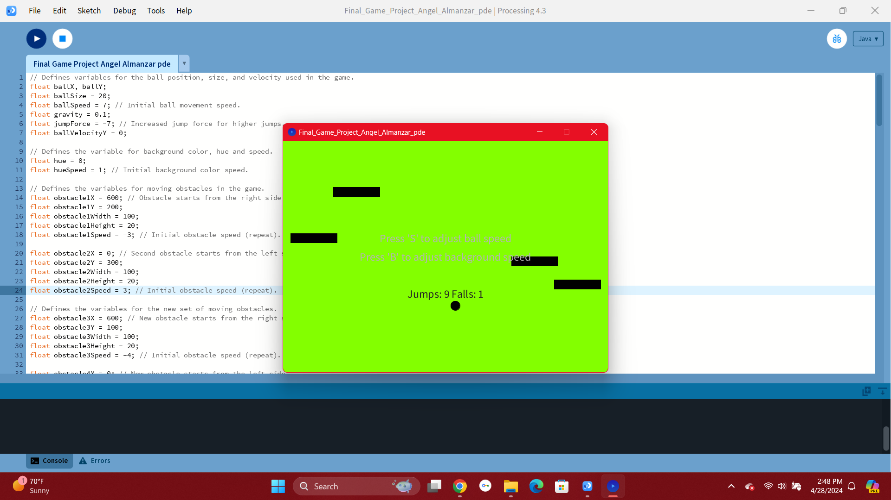
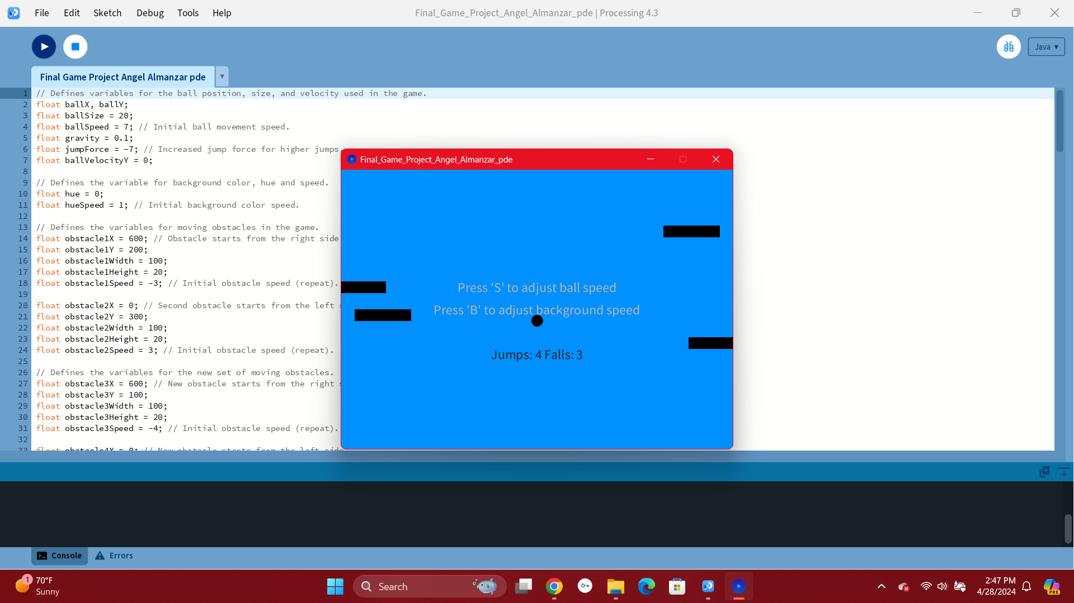
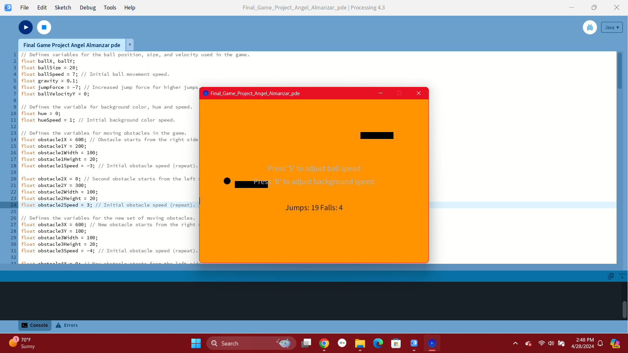
Game Screenshots:
3 Screenshots Showing the Game:
In this game you move left and right to get a higher score and once you fall 5 times the game counter resets. You can also change the speed and colors of the game.

Slide 4
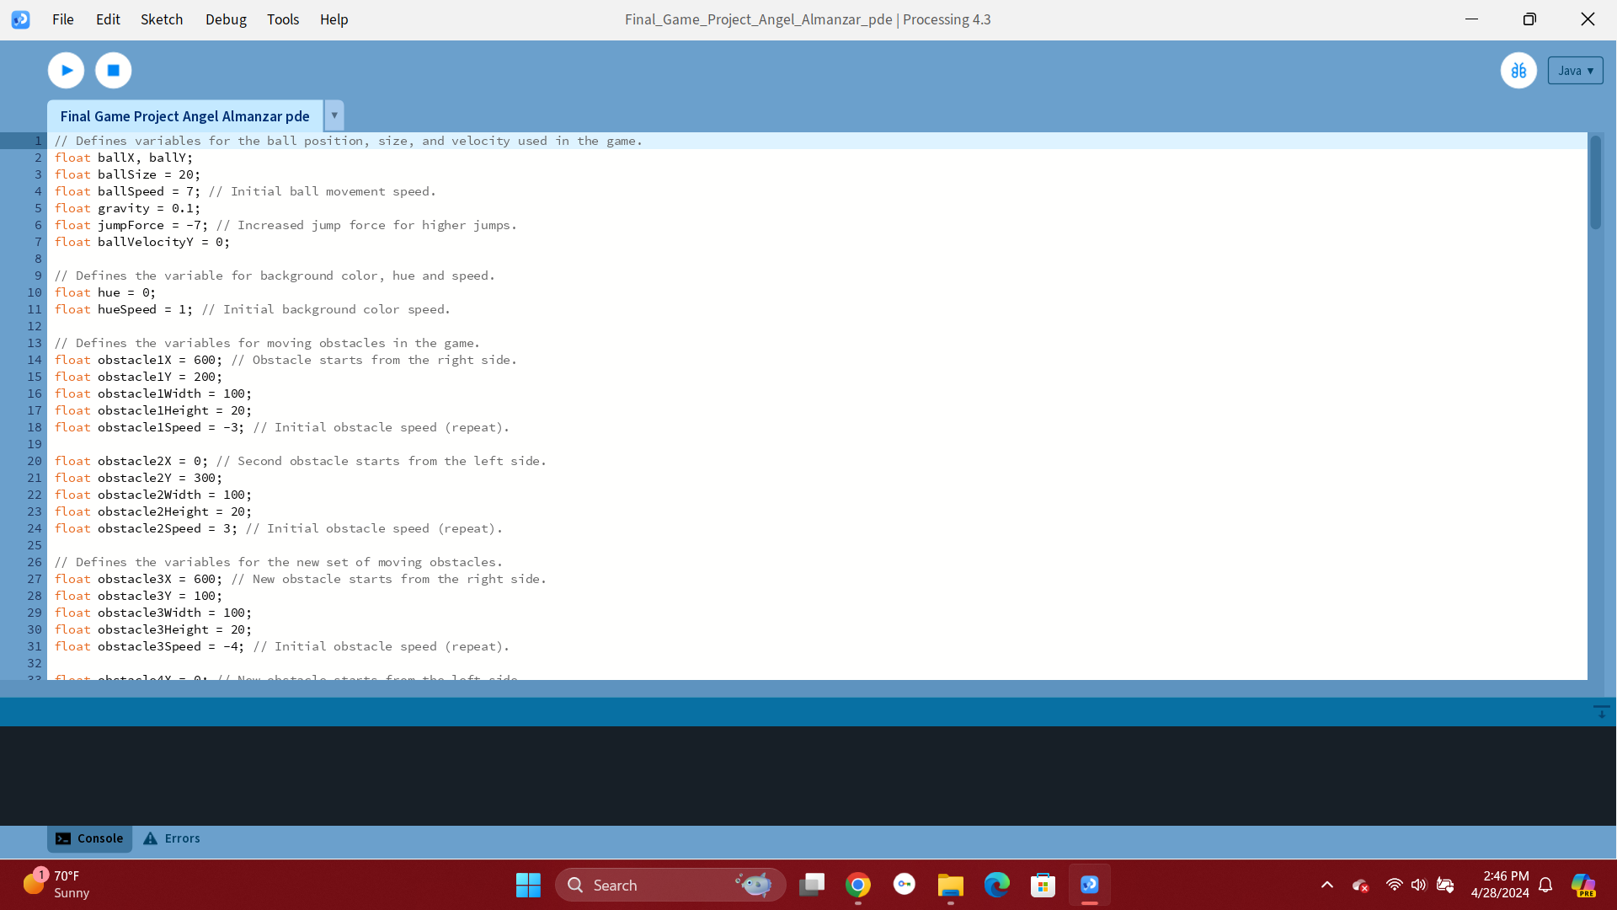
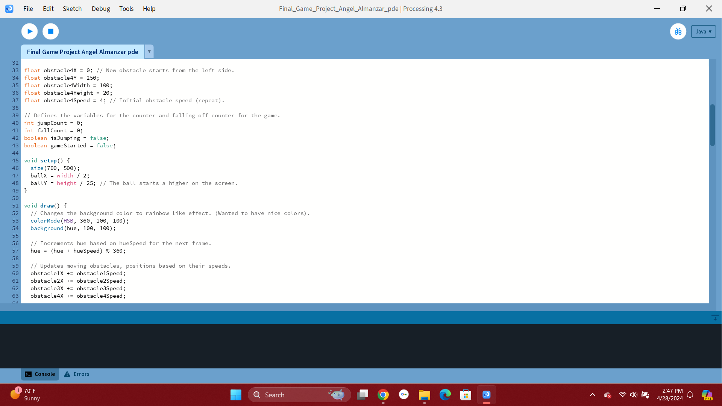
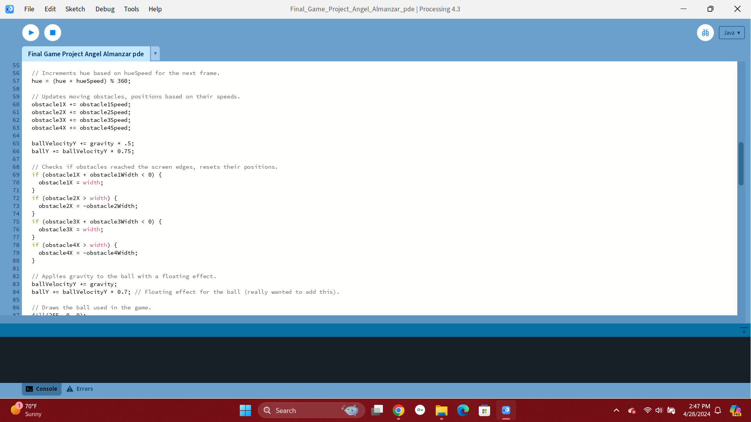
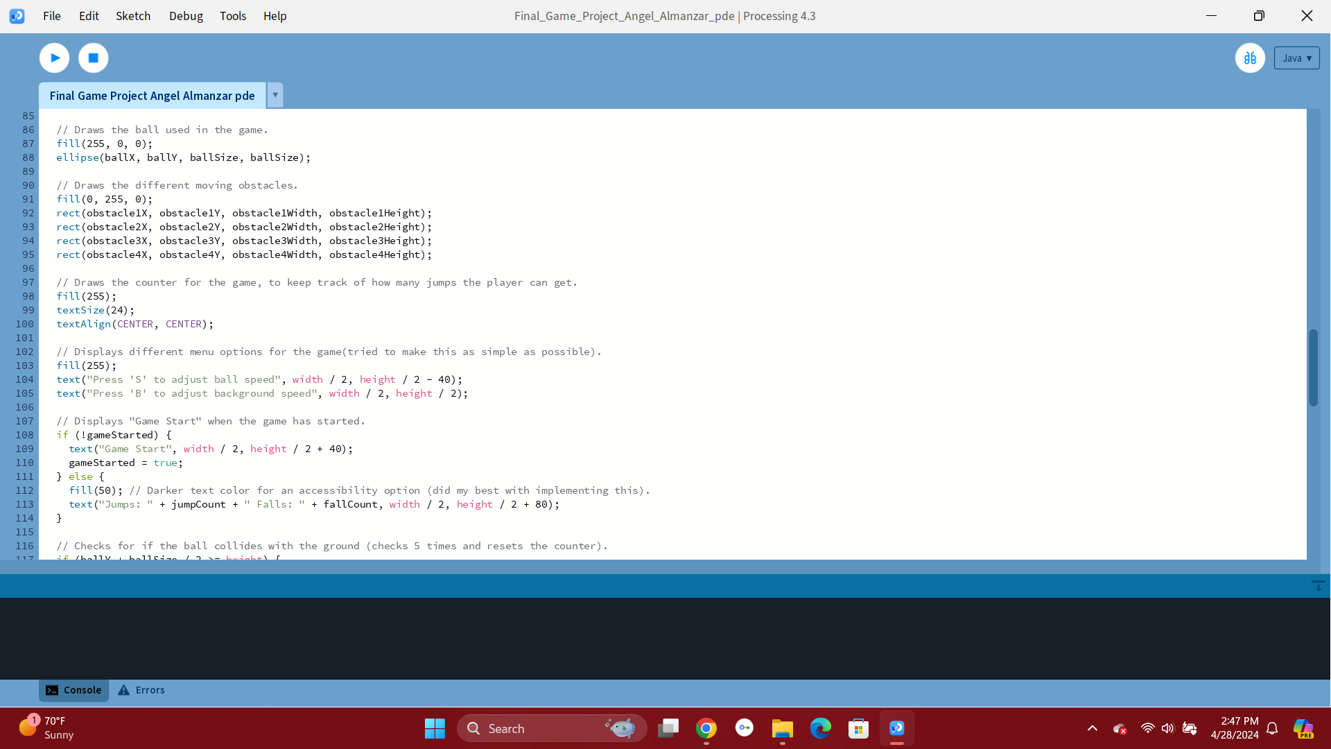
Screenshots of Code: This shows all my comments and code.
4 Code Screenshots to show how the game runs:

Slide 5
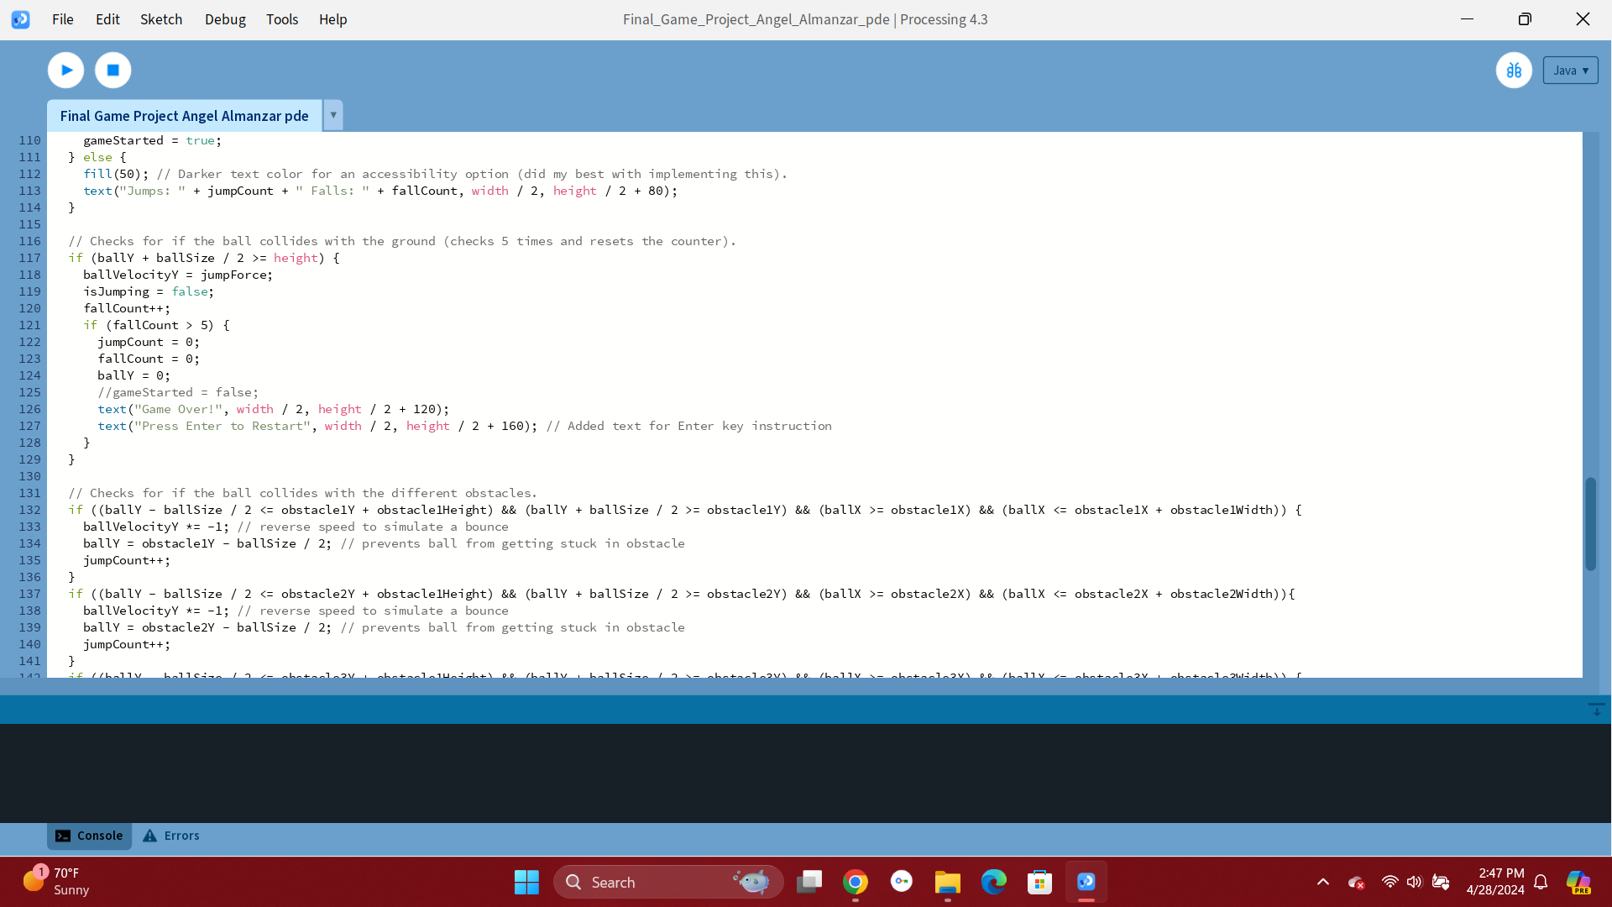
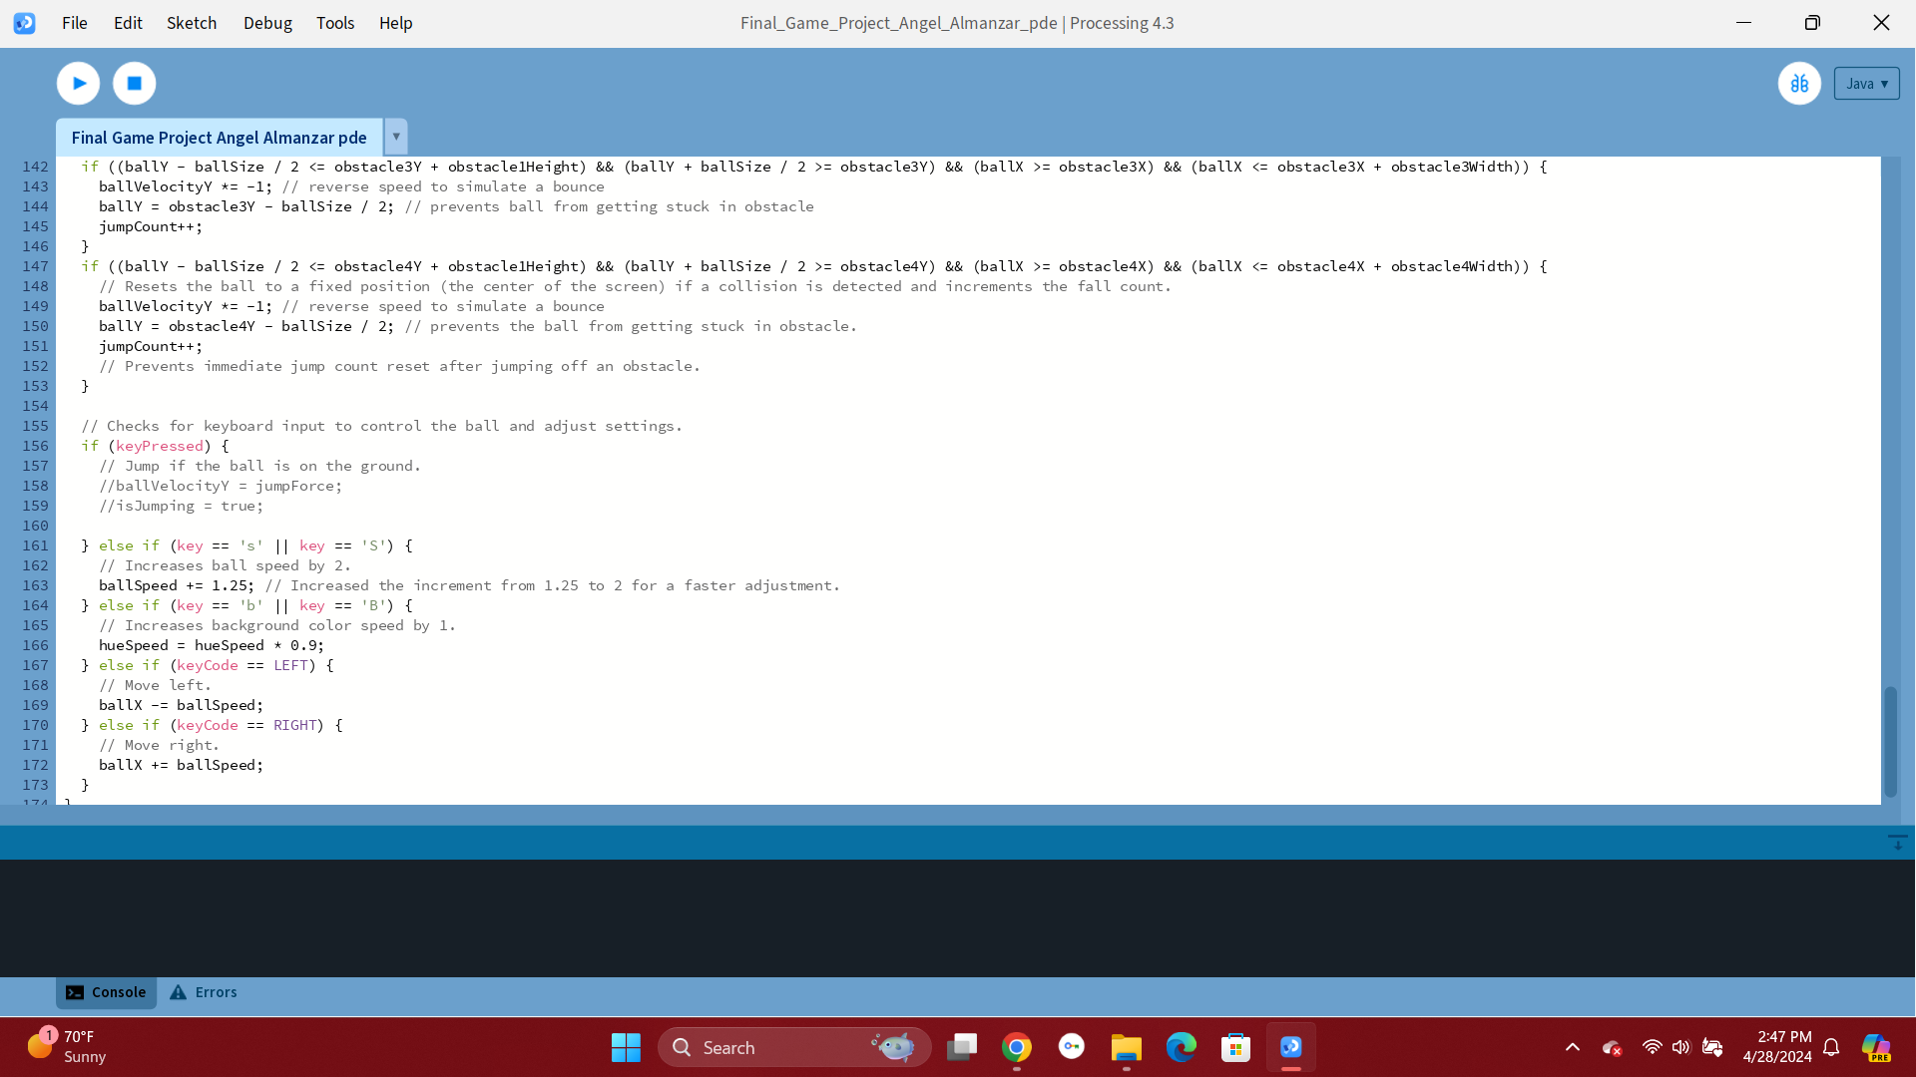
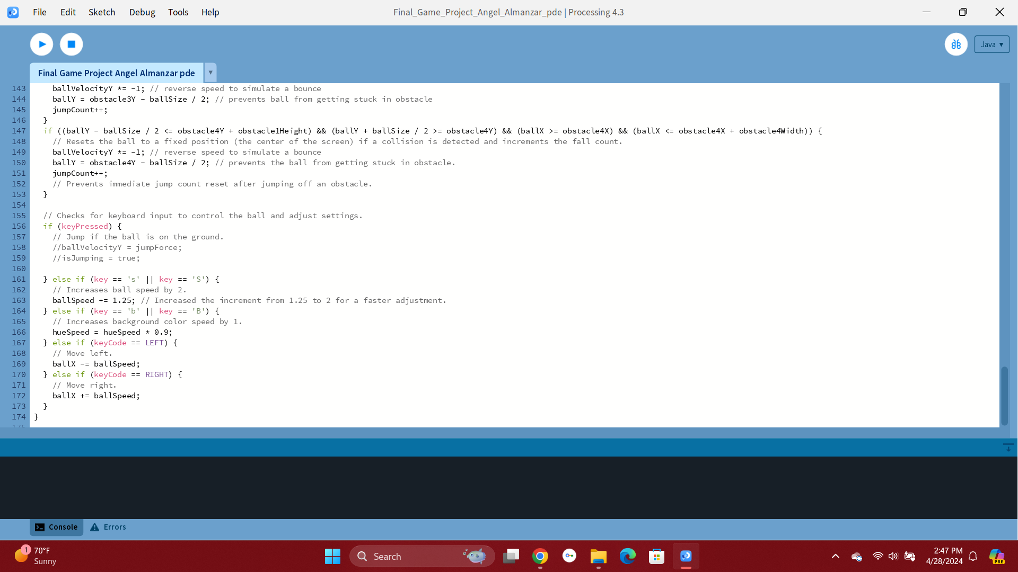
Screenshots of Code II: Showing the last bit of code.
3 Screenshots of code to show how the game runs:

Slide 6
What do I like about my code and why did I create my game the way I did?
I like how I organized the code, I tried to make it as clear as possible (make it easy to read).
I wrote my comments honestly and the best I could
My game was based off of two games I liked playing that are similar to it like “Beat Stomper” and “Smash Hit”.
I wanted to create a game that was fun and that you don’t lose in.
I wanted to create a game that was addictive to play.
In my game you aim to get the best score you can and then after falling a couple times the counters reset.

Slide 7
Problems I had making the game and how I came up with solutions:
I came across several issues when creating my game. Issues like how fast should the ball go?, how fast should the background color be when playing?,How do I fix the collision and counter glitches where it wasn't working properly? These were questions I asked myself and tried to fix the problems the best I could, but since I was fairly new with programming I got help from my tutor and friends to realize my vision of making the game I wanted to.
Most of my issues were just that I wrote the wrong syntax or the wrong number and had to play around with them. Overall I learned a lot from this project and created a game that I thought was fun.

